Slide 1


SAMEER DESHMUKH
github.com/v0dro
@v0dro

Slide 2

GOOGLE
SUMMER OF CODE 2015
www.google-melange.com

Slide 3
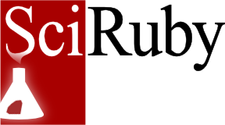
RUBY
SCIENCE
FOUNDATION
www.sciruby.com

Slide 4
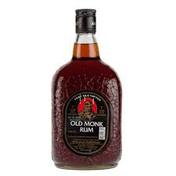
दारु

Slide 5
SEEING DATA
CLEARLY WITH
DARU

Slide 6
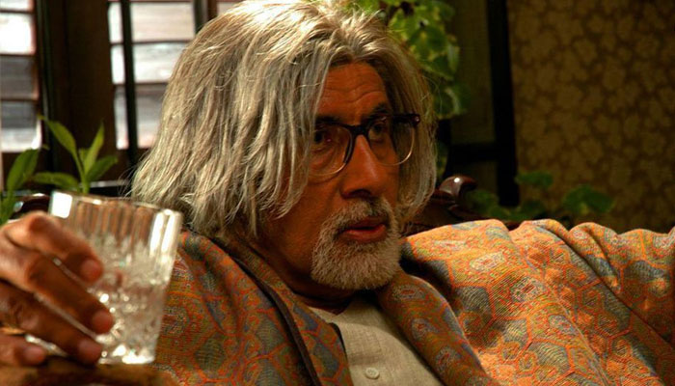
Data? Daru?....WHAT!?

Slide 7
Data
Analysis
in
RUby
is a ruby gem for analyzing, manipulating and visualizing data in Ruby.

Slide 8
Why use daru?
Robust,
Friendly
Interactive
computing
Reduce
Toolchain
Friction

Slide 9
Robust
Powerful indexing support for storage and access of data
Statistics and moving statistics functions.
Support time series.
Arel-like syntax for querying data.
Easily visualize data.
Supports operations with missing data.

Slide 10
Friendly
Builds on top of existing Ruby data structures so works with all interpreters.
Leverages specific interpreter resources whenever possible.
Integrates with other ruby scientific libraries.
Statistics – statsample, statsample-glm, statsample-timeseries, mixed_models.
Visualization – Nyaplot, GnuplotRB.
C level storage – NMatrix, rb-gsl.

Slide 11
Daru::Vector
Heterogenous Array that can be indexed on any Ruby object.
Name
Label(0)
Label(1)
Label(2)
...
Label(n-1)

Slide 12
Daru::DataFrame
2D spreadsheet like data structure indexed by rows or columns with ruby objects.
Col0
Col1
Col2
Col(n-1)
Label(0)
Label(1)
Label(2)
....
...
Label(n-1)

Slide 13
Links to notebooks
Notebook elaborting basic daru usage: http://nbviewer.ipython.org/github/v0dro/talks/blob/master/DeccanRubyConf15/Daru%20Demo.ipynb
Use Case: Analyzing baby names with daru: http://nbviewer.ipython.org/github/v0dro/talks/blob/master/DeccanRubyConf15/Use%20Case%20-%20Daru%20for%20analyzing%20baby%20names%20data.ipynb

Slide 14
{ THANK YOU }

Slide 15
Ab samajh mein aaya.

Slide 16

Koi sawaal?

